Slide 1

PaDiM: a Patch Distribution Modeling Framework for Anomaly Detection and Localization
Paper review
Gibeom Kim (UST)

Slide 2

Index
Paper abstract
1-1. Anomaly Detection
1-2. Mahalanobis Distance
Model
Conclusion
Notes:
I don't know how much you know about Padim, so I’ll explain a quick overview of the basics of Padim

Slide 3
1. Paper abstract
By using pre-trained CNN models and Gaussian Distribution for anomaly detection in images
The embedding vector is obtained from CNN model and computed to get Mahalanobis distance patch-by-patch.
Embedding vector is extracted from each layers of the CNN model, is used for considering correlations at different semantic levels.
Each patch is assumed to follow a Multivariate Gaussian Distribution.

Slide 4
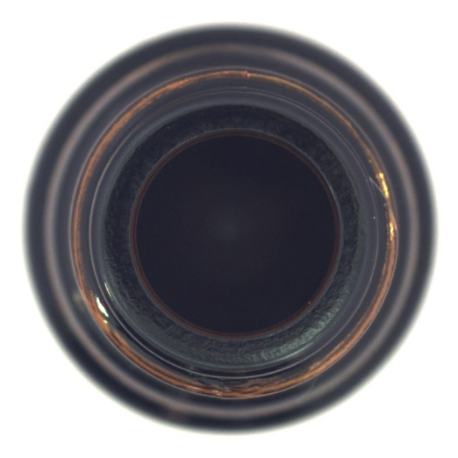
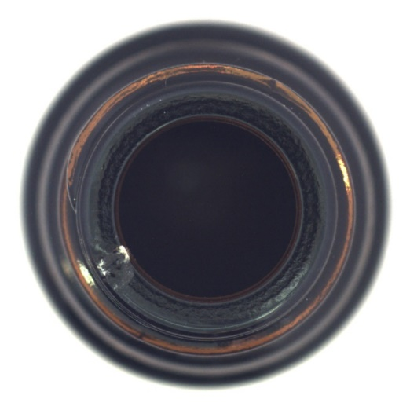
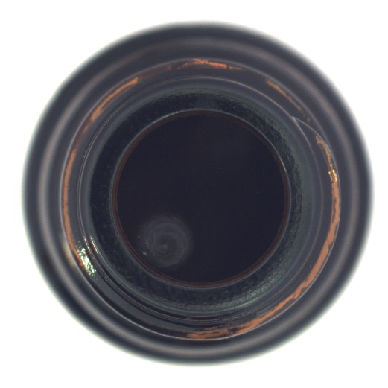
1-1. Anomaly Detection
Task to detect abnormal pattern or values from the data
Train a model using only normal images and then determine whether a given image is normal or abnormal.
In industrial site, it is easy to obtain normal images, but difficult to get various abnormal images.
Normal image
Abnormal image
Notes:
Image of the bottle from above
The mvtec dataset is a representative dataset used for anomaly detection
crack

Slide 5

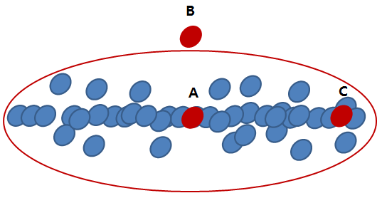
1-2. Mahalanobis Distance
Distance in Probability Distributions
A value that indicates data point is how far from that mean of a distribution by using standard deviation.
x: Individual data values
μ: Mean of the data values
S: Covariance matrix of the data
Notes:
The red circle is the set of points that have the same probability value

Slide 6
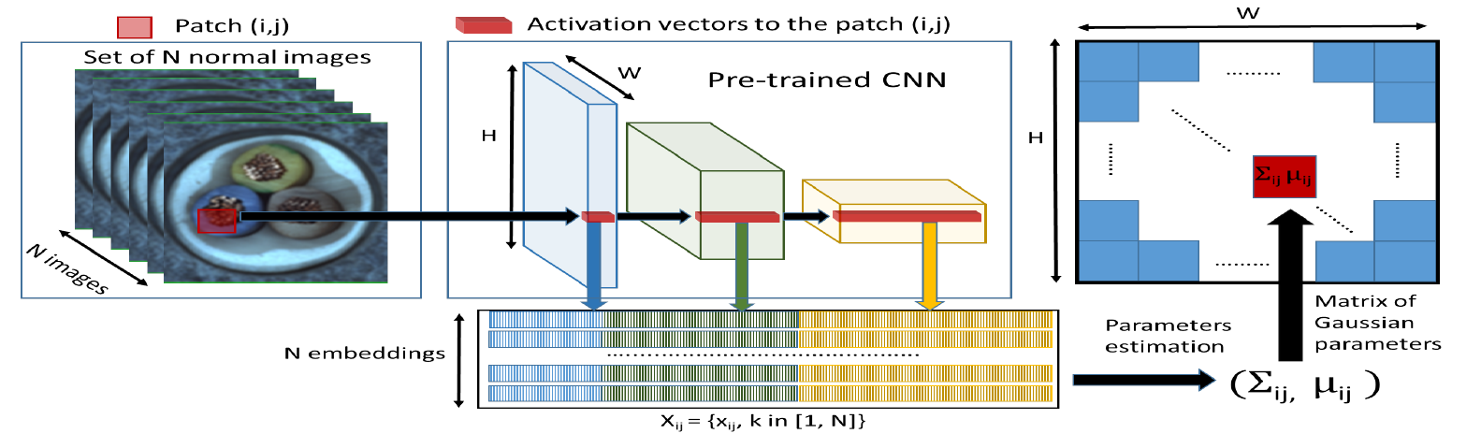
1. Paper Abstract
Simplified data processing flow of a PaDim model

Slide 7



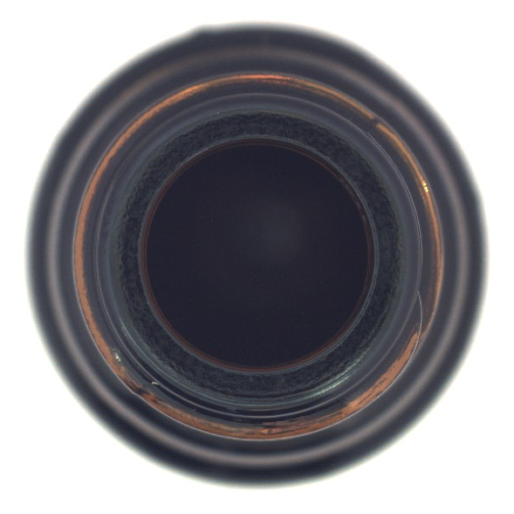



1. Paper Abstract
Original image
Channel image
Notes:
Get the data from multiple channels in the red rectangle and calculate mean and covariance.

Slide 8
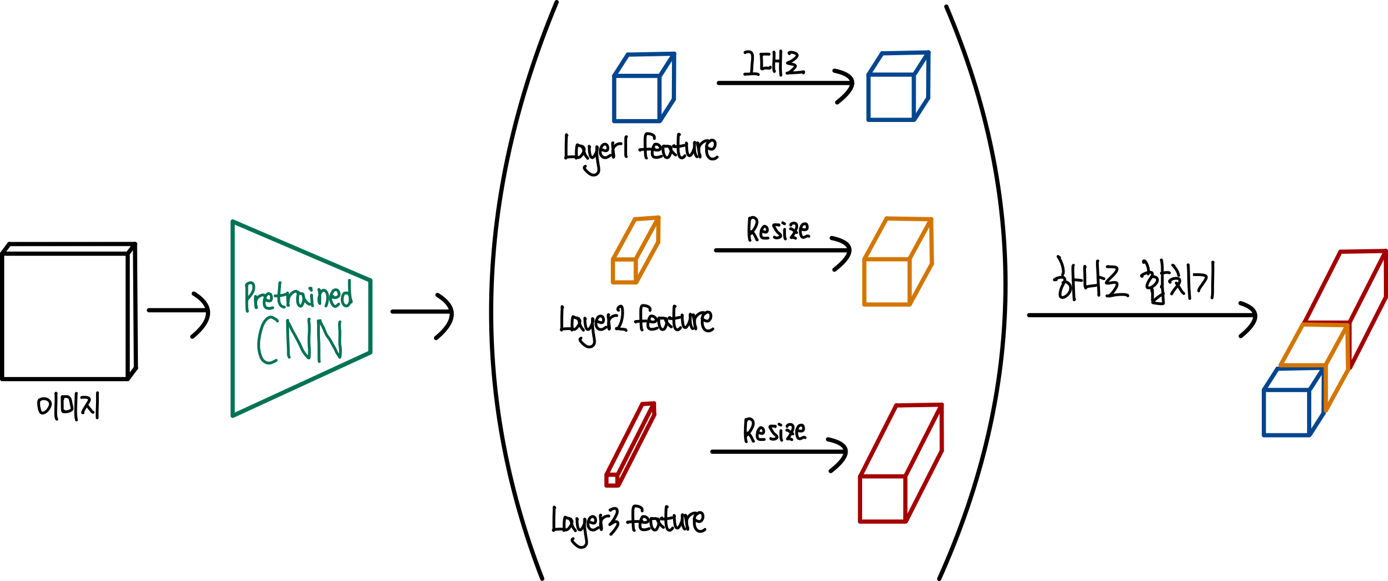
2. Model
Embedding extraction
Concatenate all features extracted from pre-trained CNN layers to a single embedding vector
For dimensionality reduction, part of channels are used to calculate mean and covariance

Slide 9
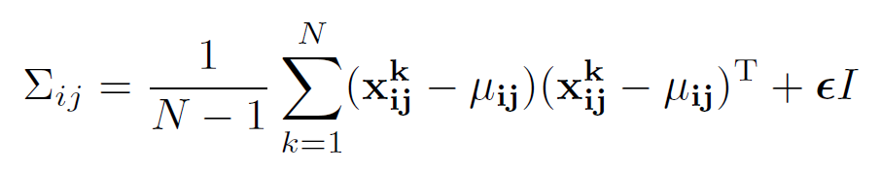

2. Model
Learning of the normality
Compute the covariance matrix and mean value for each patch
Use all training data to compute covariance matrix and mean
$$x_{ij}^{k}:The patch embedding vector corresponding to position \left(i, j\right)$$
$$in the k−th training image.$$
$N:The total number of normal training images.$
$μ_{ij}:The mean of X_{ij}, which is the average of the embedding vectors$ $for all training images at position \left(i, j\right).$
$Σ_{ij}:The covariance matrix of$ $X_{ij}$
$εI:A regularization term that ensures the covariance matrix is$ $full rank, allowing the calculation of the inverse matrix.$

Slide 10
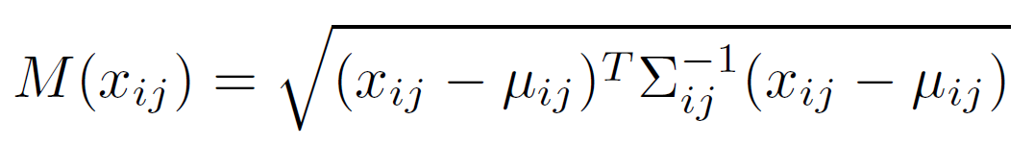
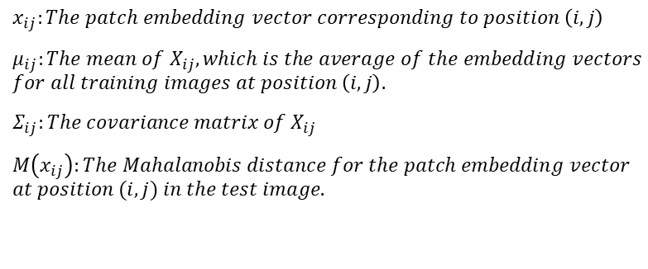
2. Model
Inference : computation of the anomaly map
Test images are input into the pre-trained CNN model in the same method as the previous process.
The Mahalanobis distance is then calculated to compare how far each patch is from the mean and covariance values of the normal images on a patch-by-patch.
$$x_{ij}:The patch embedding vector corresponding to position \left(i, j\right)$$
$μ_{ij}:The mean of X_{ij}, which is the average of the embedding vectors$ $for all training images at position \left(i, j\right).$
$Σ_{ij}:The covariance matrix of$ $X_{ij}$
$M\left(x_{ij}\right):The Mahalanobis distance for the patch embedding vector$
$$at position (i, j) in the test image.$$

Slide 11
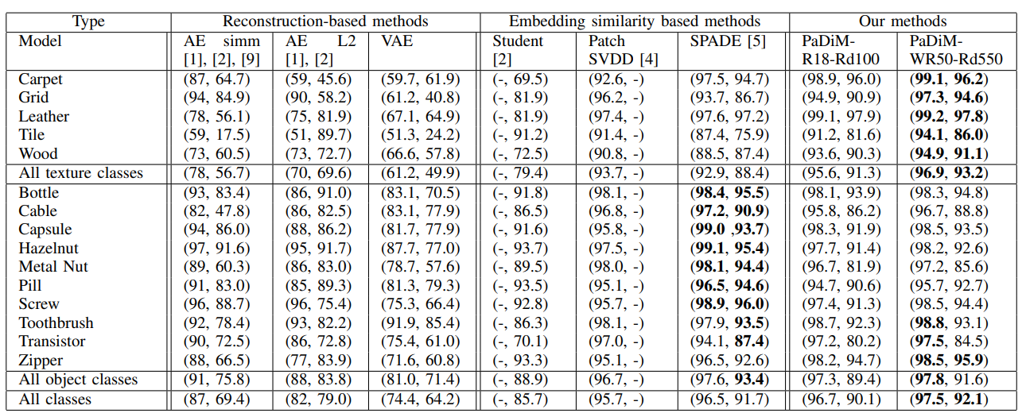
3. Conclusion
Combining the outputs of the first three layers of pre-trained CNN model and considering the correlations between them.
No need to train deep learning model, and inference taking approximately 150 seconds per class when using cpu.
Achieved State-Of-The-Art (SOTA) in 2020

Slide 12
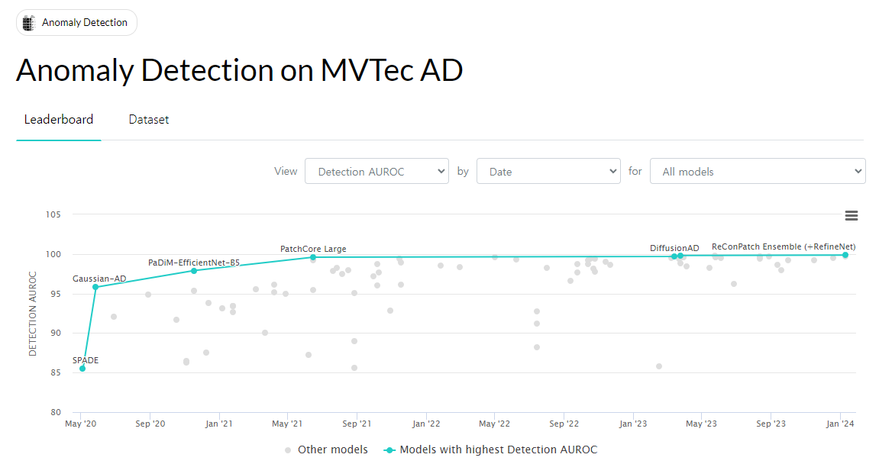
3. Conclusion

Slide 13
Thank you

